Slide 1


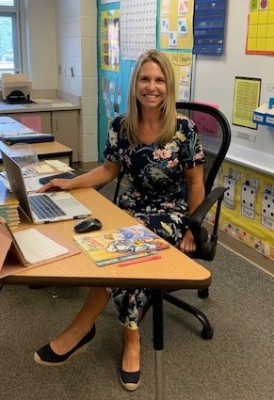


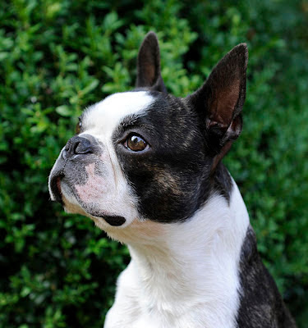

Hello 5th Grader! Welcome to a new school year! I am so excited to be your teacher. This year will be my 18th year teaching at Groveland Elementary. I can’t wait to see you very soon!
Mrs. Rantz
About Me
HOMETOWN: Bethlehem, PA
CURRENT HOME: Quakertown, PA
COLLEGE: Bloomsburg University
GRADUATE SCHOOL: Cabrini College
GRADES TAUGHT: 1st, 3rd, 6th, 8th grade Spanish
CHILDREN: 2 boys: Wyatt (13) and Grayson (10)
BIRTHDAY: September 2nd
PETS: Dog – Uma the Boston Terrier
My Favorites
Contact Me
EMAIL: krantz@cbsd.org
PHONE: 267-893-4600
COLOR: light blue
FOOD: Pretzels
CANDY: Reese’s
ANIMAL: Dog
HOBBY: Zumba
Notes:
Editable Version

